Slide 1

Reinforcement Learning
Naeemullah Khan
naeemullah.khan@kaust.edu.sa
KAUST Academy
King Abdullah University of Science and Technology

Slide 2
Reinforcement Learning
Agent
State
Action
Reward
Environment
Goal: Learn to choose actions that maximize rewards
𝑠₁, 𝑎₁, 𝑟₁, 𝑠₂, 𝑎₂, 𝑟₂, … , 𝑠_{𝑛}, 𝑎_{𝑛}, 𝑟_{𝑛} → 𝜋∗(𝑎|𝑠)

Slide 3
Imitation Learning
Agent
State
Action
Reward
Environment
Goal: Learn to choose actions that imitate an expert policy
𝑠₁, 𝑎∗, 𝑠₂, 𝑎∗, … , 𝑠_{𝑛}, 𝑎∗ → 𝜋∗(𝑎|𝑠)
1 2 𝑛

Slide 4
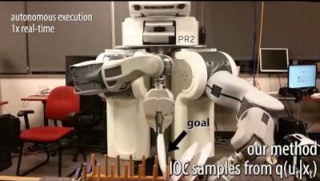
Problems with Imitation Learning
False assumption: state-action pairs are i.i.d. (independently and identically distributed
Non-smooth policy (effect on future states ignored)
Brittle policy (can’t quantify how bad are suboptimal actions, errors may compound)

Slide 5


Problems with Imitation Learning
2. Can’t easily transfer what is learned to new domains

Slide 6




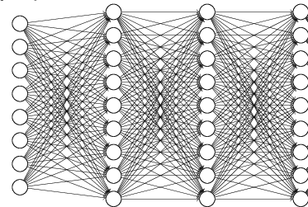


Inverse RL
“forward” reinforcement learning
inverse reinforcement learning
reward parameters

Slide 7
Inverse RL
Definition
States: 𝑠 ∈ 𝑆
(Near) optimal actions: 𝑎∗ ∈ 𝐴
Rewards: 𝑟 ∈ ℝ
Transition model: Pr(𝑠_{𝑡}|𝑠_{𝑡&1}, 𝑎_{𝑡&1})
Reward model: 𝑅 𝑠, 𝑎 = 𝐸[𝑟|𝑠, 𝑎]
Discount factor: 0 ≤ 𝛾 ≤ 1
unknown model
discounted: 𝛾 < 1 undiscounted: 𝛾 = 1
Horizon (i.e., # of time steps): ℎ
Finite horizon: ℎ ∈ ℕ infinite horizon: ℎ = ∞
Goal: find reward model 𝑅 𝑠, 𝑎 = 𝐸[𝑟|𝑠, 𝑎] such that
𝜋∗ = 𝑎𝑟𝑔𝑚𝑎𝑥_{𝜋} ∑^{h} 𝛾^{𝑡}𝐸_{𝜋}[𝐸[𝑟_{𝑡}|𝑠_{𝑡}, 𝑎_{𝑡}]]
𝑡=0

Slide 8
General Approach
Use IRL to learn reward function
Then use reward function to learn policy
Advantages:
No assumption that state-action pairs are i.i.d.
Transfer reward function to new environments

Slide 9
Inverse RL Techniques
Feature expectation matching
Maximum margin IRL
Maximum entropy IRL
Guided cost learning

Slide 10
Feature Expectation Matching
Normally: find 𝑅 such that 𝜋∗ chooses the same actions 𝑎∗ as expert
Problem: we may not have enough data for some states (especially continuous states) to properly estimate transitions and rewards
Note: rewards typically depend on features 𝜙₆ (𝑠, 𝑎)
e.g., 𝑅(𝑠, 𝑎) = ∑_{i} 𝑤_{i} 𝜙_{i} (𝑠, 𝑎) = 𝒘^{𝑇}𝝓(𝑠, 𝑎)
Idea: Compute feature expectations and match them

Slide 11

Feature Expectation Matching
Let
be the average feature count of expert 𝑒
(where 𝑛 indexes trajectories)
Let 𝝁^{𝜋}(𝑠₀) be the expected feature count of policy 𝜋
Claim: If 𝝁^{𝜋} 𝑠 = 𝝁^{𝑒} 𝑠 ∀𝑠 then 𝑉^{𝜋} 𝑠 = 𝑉^{𝑒} 𝑠 ∀𝑠

Slide 12
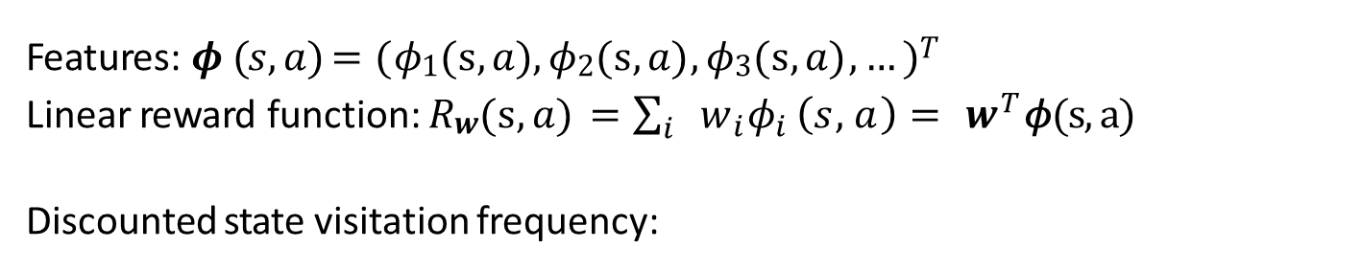
Proof
Features: 𝝓 (𝑠, 𝑎) = (𝜙₁(s, 𝑎) , 𝜙₂(s, 𝑎) , 𝜙₃(s, 𝑎) , … )^{𝑇}
Linear reward function: 𝑅_{𝒘}(s, 𝑎) = $\sum_{i}{w_{i}{\text{φ}}_{i}}\left(s,a\right)= w^{T}\text{φ}\text{(}\text{s}\text{, }\text{a}\text{)}$
Discounted state visitation frequency:
_{𝜓}𝜋
𝑠₀
𝑠′ = 𝛿(𝑠′, 𝑠₀) + 𝛾 ∑_{𝑠} 𝜓^{𝜋} (𝑠) Pr 𝑠′ 𝑠, 𝜋 𝑠
𝑠₀
Value function:
𝑉^{𝜋} 𝑠 = ∑ ' 𝜓^{𝜋} 𝑠′ 𝑅 (𝑠′, 𝜋(𝑠′))
𝑠
𝑠 𝒘
= ∑ ' 𝜓^{𝜋} 𝑠′ 𝒘^{𝑇}𝝓(𝑠′, 𝜋 𝑠′ )
𝑠
𝑠
= 𝒘^{𝑇} ∑ ' 𝜓^{𝜋} 𝑠′ 𝝓(𝑠′, 𝜋 𝑠′ )
𝑠
𝑠
= 𝒘^{𝑇} 𝝁^{𝜋}(𝑠)
Hence:
𝝁^{𝜋} 𝑠 = 𝝁^{𝑒} 𝑠
→ 𝒘^{𝑇}𝝁^{𝜋} 𝑠 = 𝒘^{𝑇}𝝁^{𝑒} 𝑠
→ 𝑉^{𝜋} 𝑠 = 𝑉^{𝑒}(𝑠)

Slide 13
Indeterminacy of Rewards
Learning 𝑅_{𝒘} 𝑠, 𝑎 = 𝒘^{𝑇}𝝓(𝑠, 𝑎) amounts to learning 𝒘
When 𝝁^{𝜋} 𝑠 = 𝝁^{𝑒} 𝑠 , then 𝑉^{𝜋} 𝑠 = 𝑉^{𝑒}(𝑠), but 𝒘 can be anything since
𝝁^{𝜋} 𝑠 = 𝝁^{𝑒} 𝑠 → 𝒘^{𝑇}𝝁^{𝜋} 𝑠
We need a bias to determine 𝒘
Ideas:
Maximize the margin
Maximize entropy
= 𝒘^{𝑇}𝝁^{𝑒} 𝑠 ∀𝒘

Slide 14
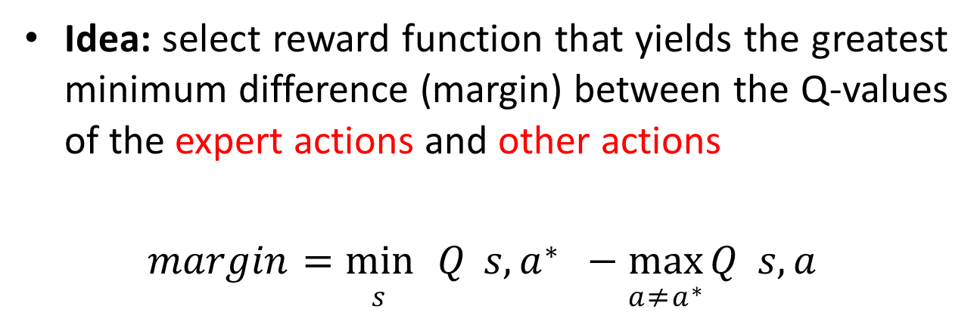
Maximum Margin IRL
Idea: select reward function that yields the greatest minimum difference (margin) between the Q-values of the expert actions and other actions
𝑚𝑎𝑟𝑔𝑖𝑛 = min 𝑄 𝑠, 𝑎∗ − max 𝑄 𝑠, 𝑎
𝑠 𝑎$≠$𝑎∗

Slide 15

Maximum Margin IRL
Let 𝝁^{𝜋} 𝑠, 𝑎 = 𝝓 𝑠, 𝑎 + 𝛾 ∑_{𝑠’} Pr 𝑠′ 𝑠, 𝑎 𝝁^{𝜋}(𝑠′)
Then 𝑄^{𝜋} 𝑠, 𝑎 = 𝒘^{𝑇}𝝁^{𝜋}(𝑠, 𝑎)
Find 𝒘∗ that maximizes margin:
𝒘∗ = 𝑎𝑟𝑔𝑚𝑎𝑥_{𝒘} min 𝒘^{𝑇}𝝁^{𝜋} 𝑠, 𝑎∗
− max 𝒘^{𝑇}𝝁^{𝜋} 𝑠, 𝑎
𝑠
𝑎$≠$𝑎∗
s.t. 𝝁^{𝜋} 𝑠, 𝑎 = 𝝁^{𝑒} 𝑠, 𝑎 ∀𝑠, 𝑎
Problem: maximizing margin is somewhat arbitrary since it doesn’t allow suboptimal actions to have values that are close to optimal

Slide 16



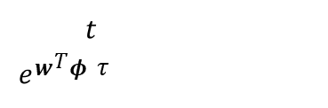
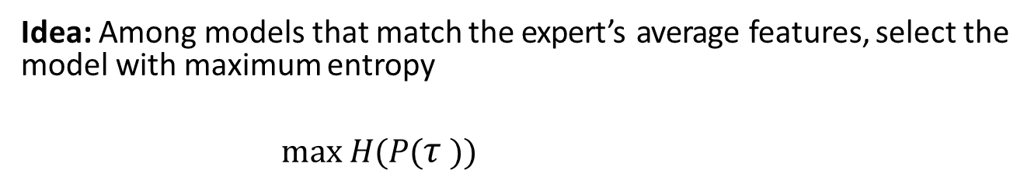







Maximum Entropy
Idea: Among models that match the expert’s average features, select the model with maximum entropy
max 𝐻(𝑃($τ$))
𝑃($τ$)
s.t.
1
∑ $τ$_{∈𝑑𝑎𝑡𝑎} 𝝓($τ$) = 𝐸[𝝓($τ$)]
data
Trajectory: $τ=(s_{0}^{τ},a_{0}^{τ},s_{1}^{τ},a_{1}^{τ}$, … , $s_{h}^{τ},a_{h}^{τ})$
Trajectory feature vector: 𝝓 ($τ$) = ∑_{𝑡} 𝛾^{𝑡}𝝓($s_{t}^{τ},a_{t}^{τ})$
𝑇
Trajectory cumulative reward: 𝑅 𝑟 = 𝒘 𝝓 ($τ$)= ∑ 𝛾^{𝑡}𝒘^{𝑇}𝝓($s_{t}^{τ},a_{t}^{τ}$)
𝑡
_{𝑒}𝒘^{𝑇}𝝓 $τ$
_{𝑒}𝑅 $τ$
Probability of a trajectory: 𝑃_{𝒘} 𝑟 =
=
∑$τ$ _{𝑒}𝑅 $τ$
∑$τ′$ _{𝑒}𝒘^{𝑇}𝝓($τ′$)
Entropy: 𝐻(𝑃($τ)$) = − ∑$τ$ 𝑃($τ$) log 𝑃($τ$)

Slide 17
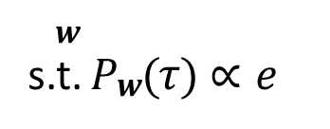
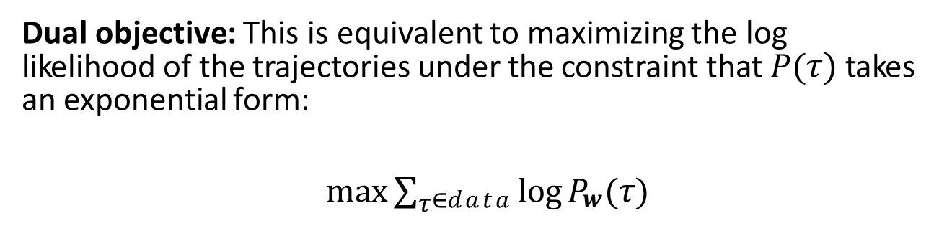

Maximum Likelihood
Maximum Entropy
max 𝐻(𝑃($τ$))
𝑃($τ$)
s.t.
1
∑ $τ$_{∈𝑑𝑎𝑡𝑎} 𝝓($τ$) = 𝐸[𝝓($τ$)]
data
Dual objective: This is equivalent to maximizing the log likelihood of the trajectories under the constraint that 𝑃($τ)$takes an exponential form:
max ∑$τ$_{∈𝑑𝑎𝑡𝑎} log 𝑃_{𝒘}($τ$)
𝒘
s.t. 𝑃_{𝒘}($τ$) $∝$ 𝑒
𝒘^{𝑇}𝝓($τ$)

Slide 18
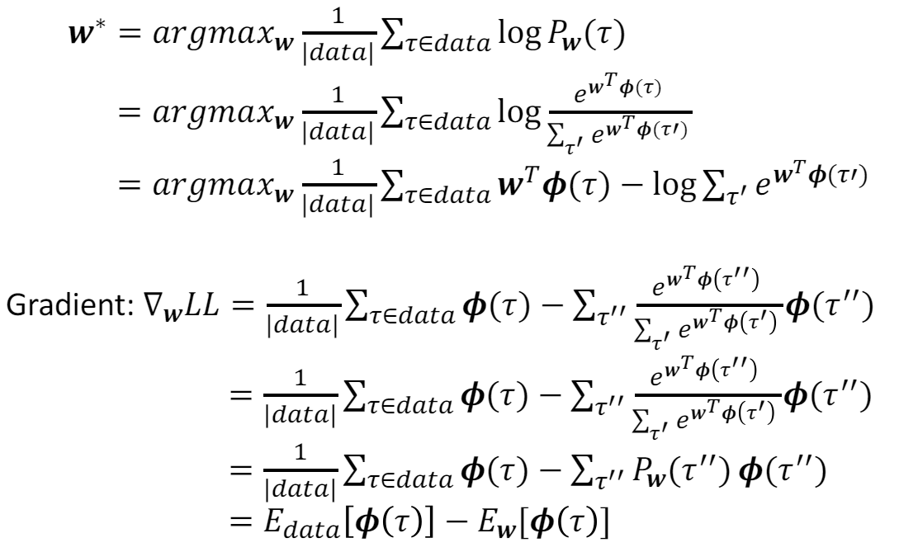
Maximum Log Likelihood (LL)

Slide 19


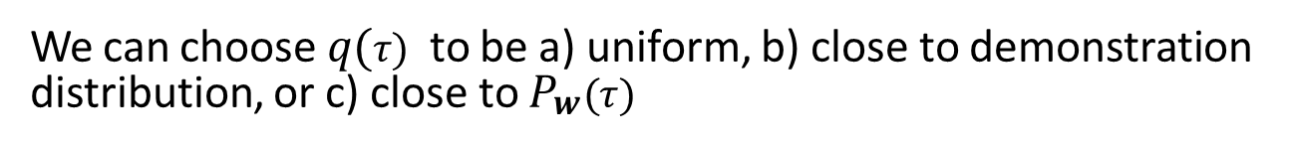
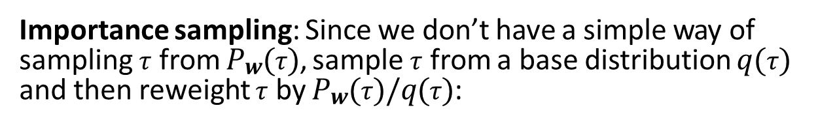
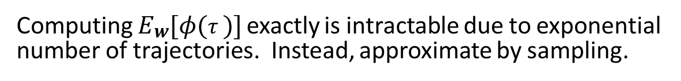
Gradient estimation
Computing 𝐸_{𝒘}[𝜙($τ$)] exactly is intractable due to exponential number of trajectories. Instead, approximate by sampling.
Importance sampling: Since we don’t have a simple way of sampling $τ$ from 𝑃_{𝒘}($τ$), sample $τ$ from a base distribution 𝑞($τ$) and then reweight $τ$ by 𝑃_{𝒘}($τ$)/𝑞($τ$):
We can choose 𝑞($τ)$ to be a) uniform, b) close to demonstration distribution, or c) close to 𝑃_{𝒘} $(τ)$

Slide 20
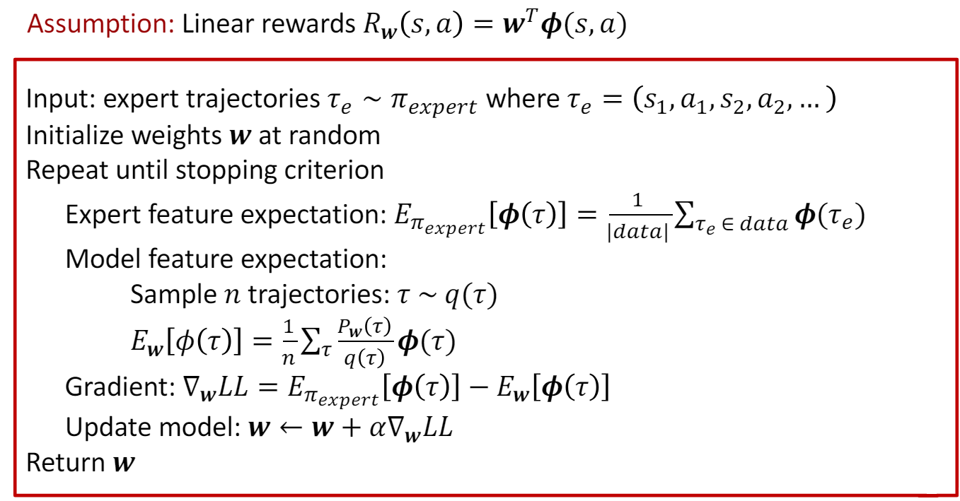
Maximum Entropy IRL Pseudocode

Slide 21
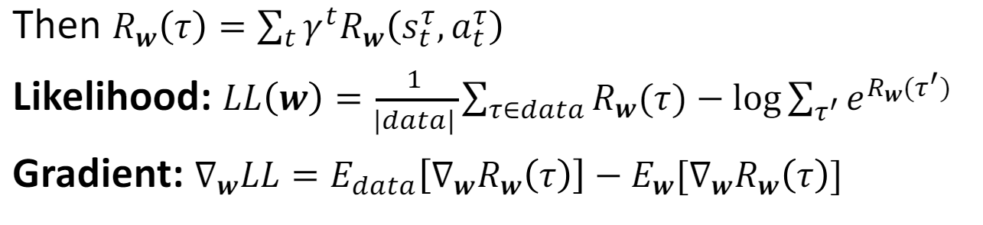
Non-Linear Rewards
Suppose rewards are non-linear in 𝒘
e.g., 𝑅_{𝒘} 𝑠, 𝑎 = 𝑁𝑒𝑢𝑟𝑎𝑙𝑁𝑒𝑡_{𝒘}(𝑠, 𝑎)

Slide 22
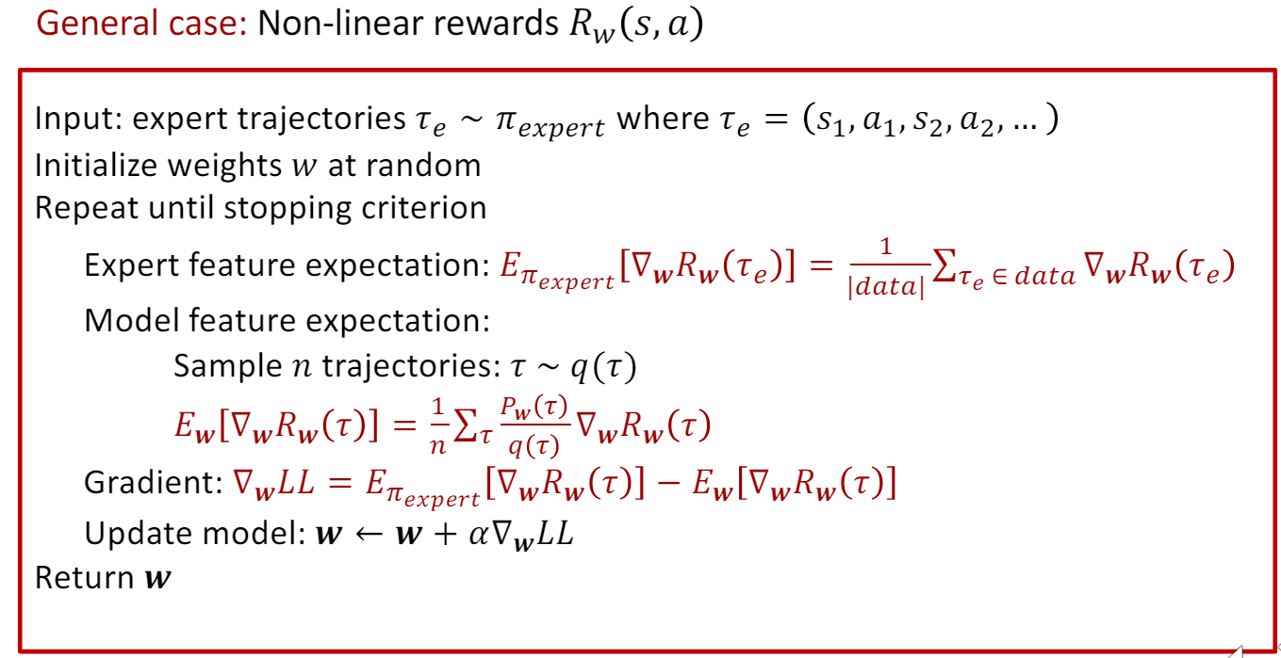
Maximum Entropy IRL Pseudocode

Slide 23
Limitations of Maximum Entropy IRL
Applicability of vanilla Maximum Entropy IRL suffers from some limitations:
Linear reward model
Need to learn a transition model (model-based)
Need to solve MDP repeatedly

Slide 24
Guided Cost Learning
Extension of maximum entropy IRL to
Non-linear reward functions
Model-free techniques (no explicit transition model)
Iterative IRL (no repeated explicit MDP solving)

Slide 25
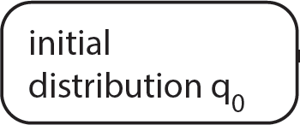
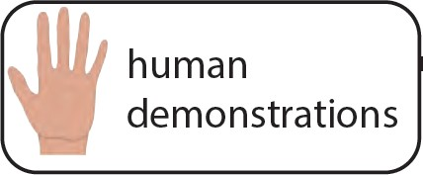
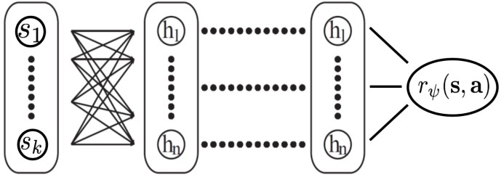
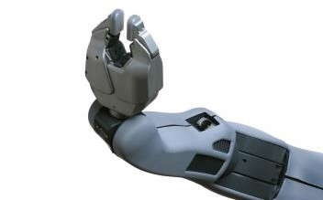
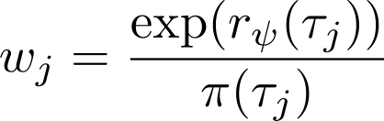
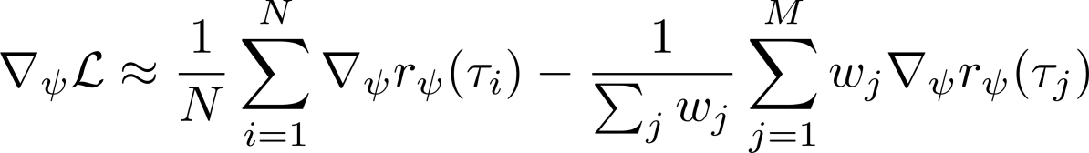
Guided Cost Learning algorithm
(Finn et al. ICML ’16)
policy π
generate policy
samples from π
Update reward using samples & demos
update π w.r.t. reward
policy π reward r
slides adapted from C. Finn

Slide 26
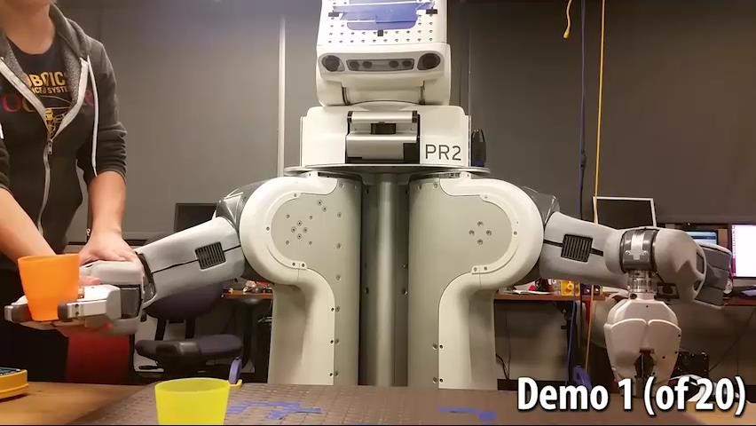
Example: learning pouring with a robot
Finn et al. Guided cost learning.

Slide 27


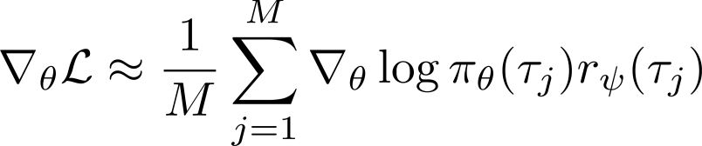
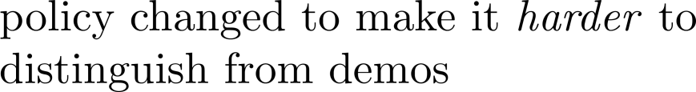
It looks a bit like a game…
policy π

Slide 28
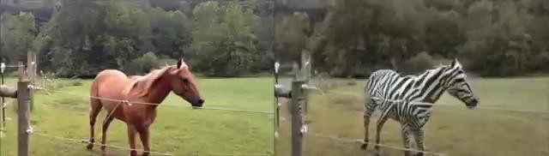
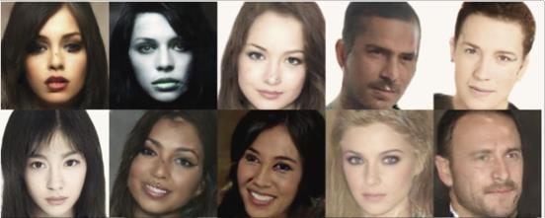
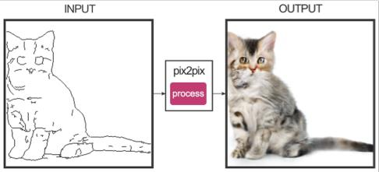

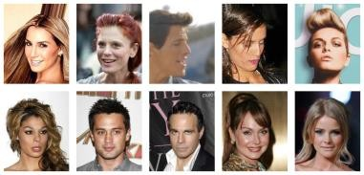



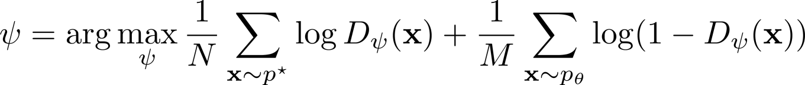

Generative Adversarial Networks
Zhu et al. ‘17
Arjovsky et al. ‘17
Isola et al. ‘17
Goodfellow et al. ‘14

Slide 29
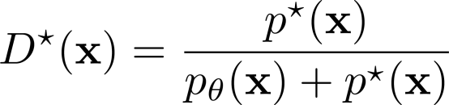
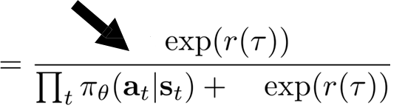
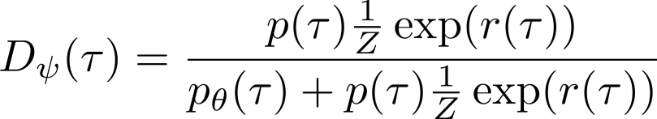

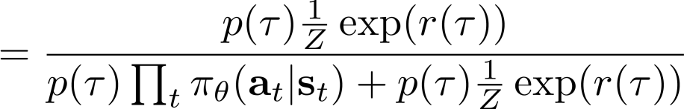
Inverse RL as a GAN
Finn*, Christiano* et al. “A Connection Between Generative Adversarial Networks, Inverse Reinforcement Learning, and Energy-Based Models.”

Slide 30




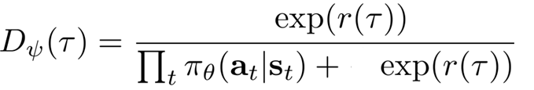
Inverse RL as a GAN
Finn*, Christiano* et al. “A Connection Between Generative Adversarial Networks, Inverse Reinforcement Learning, and Energy-Based Models.”

Slide 31


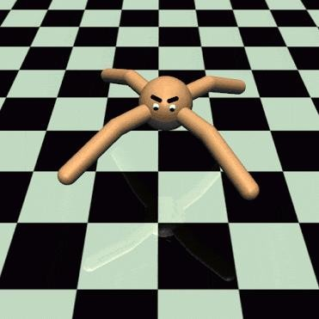
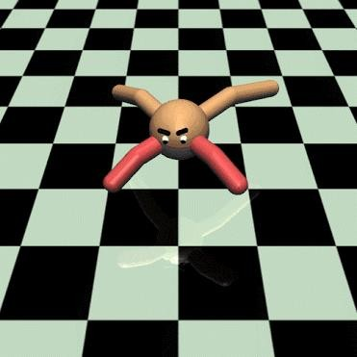
Generalization via inverse RL
what can we learn from the demonstration to enable better transfer?
need to decouple the goal from the dynamics!
policy = reward + dynamics
demonstration
reproduce behavior under different conditions
Fu et al. Learning Robust Rewards with Adversarial Inverse Reinforcement Learning

Slide 32
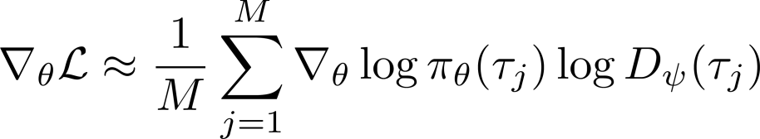
Can we just use a regular discriminator?
Pros & cons:
+ often simpler to set up optimization, fewer moving parts
discriminator knows nothing at convergence
generally cannot reoptimize the “reward”
Ho & Ermon. Generative adversarial imitation learning.

Slide 33
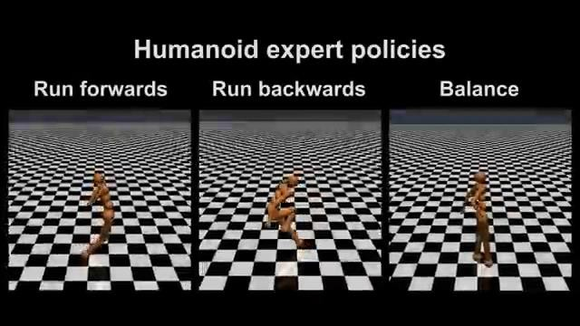





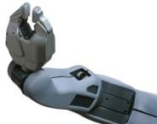
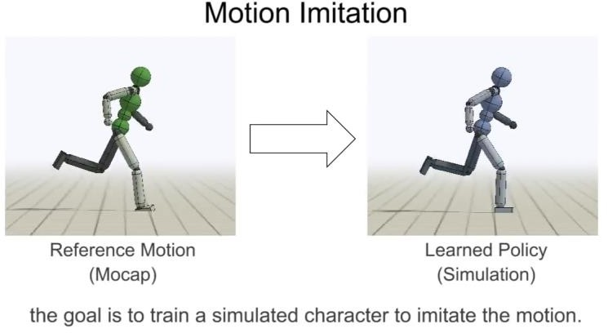
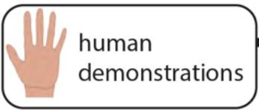
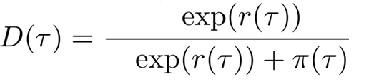

IRL as adversarial optimization
Guided Cost Learning ICML 2016
Generative Adversarial Imitation Learning
Ho & Ermon, NIPS 2016
reward function
classifier
Hausman, Chebotar, Schaal, Sukhatme, Lim
robot attempt
robot attempt
actually the same thing!
Peng, Kanazawa, Toyer, Abbeel, Levine

Slide 34
References
These slides have been adapted from
Sergey Levine, CS 285: Deep Reinforcement Learning, UC Berkeley
Pascal Poupart, CS885: Reinforcement Learning, Unversity of Waterloo

